Slide 1

The Practice of Computing Using Python
Third Edition
Chapter 14
Files and Exceptions II
Copyright © 2017, 2013, 2011 Pearson Education, Inc. All Rights Reserved
Notes:
If this PowerPoint presentation contains mathematical equations, you may need to check that your computer has the following installed:
1) MathType Plugin
2) Math Player (free versions available)
3) NVDA Reader (free versions available)

Slide 2
What we already know 1
Files are bytes on disk. Two types, text and binary (we are working with text)
open creates a connection between the disk contents and the program
different modes of opening a file, 'r', 'w', 'a'
files might have different encodings (default is utf_8)

Slide 3
More of What We Know 1
all access, reading or writing, to a text file is by the use of strings
iteration via a for loop gathers info from a file opened for reading one line at a time
we write to a file opened for reading using the print function with an argument file=

Slide 4
Code Listing 14.1

Slide 5
Results, Searching for "This"

Slide 6



More ways to read
Reads the entire contents of the file as a string and returns it. It can take an optional argument integer to limit the read to N bytes, that is my_file.read(N)
Delivers the next line as a string.
Returns a single list of all the lines from the file

Slide 7
Example File
We'll work with a file called temp.txt which has the following file contents
First Line
Second Line
Third Line
Fourth Line

Slide 8
Other File Access Methods, Reading (1 of 3)

Slide 9
Other File Access Methods, Reading (2 of 3)

Slide 10
Other File Access Methods, Reading (3 of 3)

Slide 11


More ways to write
Once opened, you can write to a file (if the mode is appropriate):
Writes the string s to the file
write a list of strings (one at a time) to the file

Slide 12
Other File Access Methods, Writing

Slide 13
Universal New Line

Slide 14
Different OS's, different format
Each operating system (Windows, OS X, Linux) developed certain standards for representing text
In particular, they chose different ways to represent the end of a file, the end of a line, etc.

Slide 15
Table 14.1 End-of-Line Characters
Operating System | Character Combination
Unix & Mac OS X | ‘\n’
MS Windows | ‘\r\n’
Mac (pre-OS X) | ‘\r’

Slide 16
Universal new line
To get around this, Python provides by default a special file option to deal with variations of OS text encoding called Universal new line
you can over-ride this with an option to open called newline=
look at the docs for what this entails.

Slide 17
Working with a file

Slide 18
The current file position
Every file maintains a current file position.
It is the current position in the file, and indicates what the file will read next
Is set by the mode table above

Slide 19
Remember the file object buffer
When the disk file is opened, the contents of the file are copied into the buffer of the file object
Think of the file object as a very big list, where every index is one of the pieces of information of the file
The current position is the present index in that list

Slide 20
Figure 14.1 Current File Position

Slide 21
The Tell() Method
The tell() method tells you the current file position
The positions are in bytes (think characters for UTF-8) from the beginning of the file
my_file.tell() => 42L

Slide 22
The Seek() Method
the seek() method updates the current file position to a new file index (in bytes offset from the beginning of the file)
fd.seek(0) # to the beginning of the file
fd.seek(100) # 100 bytes from beginning

Slide 23
Counting Bytes Is a Pain
counting bytes is a pain
seek has an optional argument set:
0: count from the beginning
1: count for the current file position
2: count from the end (backwards)

Slide 24
Every Read Moves Current Forward
every read/ readline / readlines moves the current pos forward
when you hit the end, every read will just yield '' (empty string), since you are at the end
no indication of end-of-file this way!
you need to seek to the beginning to start again (or close and open, seek is easier)

Slide 25
Moving Around in a File

Slide 26
with statement
open and close occur in pairs (or should) so Python provides a shortcut, the with statement
creates a context that includes an exit which is invoked automatically
for files, the exit is to close the file
with expression as variable:
suite

Slide 27
File Is Closed Automatically When the Suite Ends

Slide 28
Read(size=1)
You can use the read() method to read just one byte at a time, and in combination with seek move around the file and “look for things”. Once current is set, you can begin reading again

Slide 29
More on C S V files

Slide 30
Spreadsheets
The spreadsheet is a very popular, and powerful, application for manipulating data
Its popularity means there are many companies that provide their own version of the spreadsheet
It would be nice if those different versions could share their data

Slide 31
C S V, basic sharing
A basic approach to share data is the comma separated value (C S V) format
it is a text format, accessible to all apps
each line (even if blank) is a row
in each row, each value is separated from the others by a comma (even if it is blank)
cannot capture complex things like formula

Slide 32
Spread sheet and corresponding C S V file
A simple spreadsheet from Microsoft Excel 2008.
Name | Exam 1 | Exam 2 | Final Exam | Overall Grade
Bill | 75.00 | 100.00 | 50.00 | 75.00
Fred | 50.00 | 50.00 | 50.00 | 50.00
Irving
Monty | 100.00 | 100.00 | 100.00 | 100.00
blank | blank | blank | blank | blank
Average |  |  |  | 56.25

Slide 33
Even C S V isn't universal
As simple as that sounds, even C S V format is not completely universal
different apps have small variations
Python provides a module to deal with these variations called the csv module
This module allows you to read spreadsheet info into your program

Slide 34
C S V Reader
import the c s v module
open the file as normally, creating a file object.
create an instance of a c s v reader, used to iterate through the file just opened
you provide the file object as an argument to the constructor
iterating with the reader object yields a row as a list of strings

Slide 35
Code Listing 14.2 (and output)

Slide 36
Things to Note
Universal new line is working by default
needed for this worksheet
A blank line in the C S V shows up as an empty list
empty column shows up as an empty string in the list

Slide 37
C S V writer
much the same, except:
the opened file must have write enabled
the method is writerow, and it takes a list of strings to be written as a row

Slide 38
Code Listing 14.3
This code listing is a good example of reading, modifying and then writing out a C S V file that could be read by a spreadsheet
It involves lots of slicing (and has comments) so it is a good exercise

Slide 39
Os module

Slide 40
What is the Os Module
The os module in Python is an interface between the operating system and the Python language.
As such, it has many sub-functionalities dealing with various aspects.
We will look mostly at the file related stuff

Slide 41
What is a directory/folder?
Whether in Windows, Linux or on OS X, all OS's maintain a directory structure.
A directory is a container of files or other directories
These directories are arranged in a hierarchy or tree
remember hierarchy from chapter 12

Slide 42
Computer Science tree
it has a root node, with branch nodes, ends in leaf nodes
the directory structure is hierarchy (tree)

Slide 43
Directory tree
Directories can be organized in a hierarchy, with the root directory and subsequent branch and leaf directories
Each directory can hold files or other directories
This allows for sub and super directories
just like in subclass/superclass in chapter 12

Slide 44
File Path Is A Path Through The Tree
A path to a file is a path through the hierarchy to the node that contains a file
/bill/python/code/myCode.py
path is from the root node /, to the bill directory, to the python directory, to the code directory where the file myCode.py resides

Slide 45
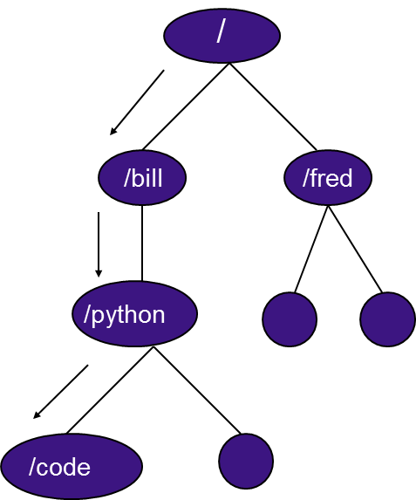
The / in a Path
think of / as an operator, showing something is a directory
follow the path, the leaf is either a directory or file

Slide 46
A Path String
a valid path string for python is a string which indicates a valid path in the directory structure
Thus '/Users/bill/python/code.py'is a valid path string

Slide 47
Different 'Paths' for Different Os
It turns out that each OS has its own way of specifying a path
C:\bill\python\myFile.py
/Users/bill/python/myFile.py
Nicely, Python knows that and translates to the appropriate OS

Slide 48
Two special directory names
The directory name '.' is shortcut for the name of the current directory you are in as you traverse the directory tree
The directory name '..' is a shortcut for the name of the parent directory of the current directory you are in

Slide 49



Some Os commands (1 of 2)
Returns the full path of the current working directory
Change the current directory to the path provided
Return a list of the files and directories in the path (including '.')

Slide 50
Some Os commands (2 of 2)

Slide 51



Some More Os Commands
Renames a file or directory
make a new directory. So
os.mkdir('/Users/bill/python/new')
creates the directory new under the directory python.
Removes the file
Removes the directory, but the directory must be empty

Slide 52


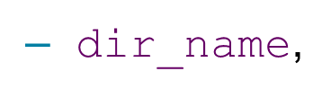


The Walk Function
Starts at the directory in
It yields three values:
name of the current directory
list of subdirectories in the directory
list of files in the directory
If you iterate through, walk will visit every directory in the tree. Default is top down

Slide 53
Walk example

Slide 54
os.path module

Slide 55
os.path module
allows you to gather some info on a path's existence
os.path.isfile(path_str) is this a path to an existing file (T/F)
os.path.isdir(path_str) is this a path to an existing directory (T/F)
os.path.exists(path_str) the path (either as a file or directory) exists (T/F)

Slide 56
os.path names
assume p = '/Users/bill/python/myFile.py'
os.path.basename(p) returns 'myFile.py'
os.path.dirname(p) returns '/Users/bill/python'
os.path.split(p) returns ['Users/bill/python','myFile.py']
os.path.splitext(p) returns '/Users/bill/python/myFile', '.py'
os.path.join(os.path.split(p)[0],'other.py') returns '/Users/bill/python/other.py'

Slide 57
Utility to find strings in files
The main point of this function is to look through all the files in a directory structure and see if a particular string exists in any of those files
Pretty useful for mining a set of files
lots of comments so you can follow

Slide 58
Code Listing 14.4

Slide 59
More Exceptions

Slide 60
What we already know 2
try-except suite to catch errors:
try:
suite to watch
except ParticularError
error suite

Slide 61
more of what we know 2
try suite contains code that we want to watch:
if an error occurs the try suite stops and looks for an except suite that can handle the error
except suite has a particular error it can handle and a suite of code for handling that error

Slide 62
Error Flow
Figure 14.5 Exception Flow

Slide 63
Code Listing 14.5 (1 of 2)

Slide 64
Code Listing 14.5 (2 of 2)

Slide 65
Check for specific exceptions
Turns out that you don’t have to check for an exception type. You can just have an exception without an particular error and it will catch anything
That is a bad idea. How can you fix (or recover from) an error if you don’t know the kind of exception
Label your exceptions, all that you expect!

Slide 66
What exceptions are there?
In the present Python, there is a set of exceptions that are pre-labeled.
To find the exception for a case you are interested it, easy enough to try it in the interpreter and see what comes up
The interpreter tells you what the exception is for that case.

Slide 67
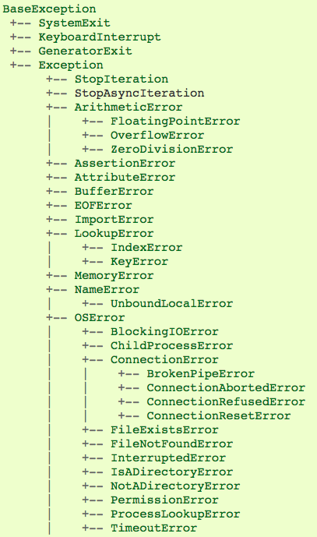
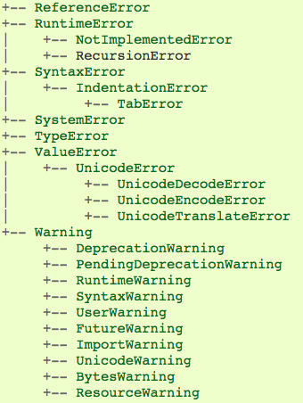
From Python Docs Webpage

Slide 68


Examples
In [1]: 1/0Out [1]:
Traceback (most recent call last): File "<pyshell#9>", line 1, in <module> 1/0
ZeroDivisionError: integer division or modulo by zero
In [2]: open("junk")
Out [2]: Traceback (most recent call last): File "<stdin>", line 1, in <module>
FileNotFoundError: [Errno 2] No such file or directory: 'junk'
error
names
CAPS
matter!

Slide 69
Philosophy of Exception Handling

Slide 70
Dealing with problems
Two ways to deal with exceptions
L B Y L: Look Before you Leap
E A F P: Easier to Ask Forgiveness than Permission (famous quote by Grace Hopper)

Slide 71
Look Before You Leap
By this we mean that before we execute a statement, we check all aspects to make sure it executes correctly:
if it requires a string, check that
if it requires a dictionary key, check that
Tends to make code messy. The heart of the code (what you want it to do) is hidden by all the checking.

Slide 72
Easier to Ask Forgiveness than Permission
By this we mean, run any statement you want, no checking required
However, be ready to “clean up any messes” by catching errors that occur
The try suite code reflects what you want to do and the except code what you want to do on error. Cleaner separation!

Slide 73
Python likes EAFP
Code Python programmers support the E A F P approach:
run the code, let the except suites deal with the errors. Don’t check first.

Slide 74
Code Listing 14-6

Slide 75
Extensions to the Basic Exception Model

Slide 76
Version 2, Finally Suite
you can add a finally suite at the end of the try/except group
the finally suite is run as you exit the try/except suite, no matter whether an error occurred or not.
even if an exception raised in the try suite was not handled!
Gives you an opportunity to clean up as you exit the try/except group

Slide 77
Finally and With
finally is related to a with statement:
creates a context (the try suite)
has an exit, namely execute the finally suite

Slide 78
Version 3, else
One way to think about things is to think of the try as a kind of condition (an exception condition) and the excepts as conditional clauses
if an exception occurs then you match the exception
the else clause covers the non-exception condition. It runs when the try suite does not encounter an error.

Slide 79
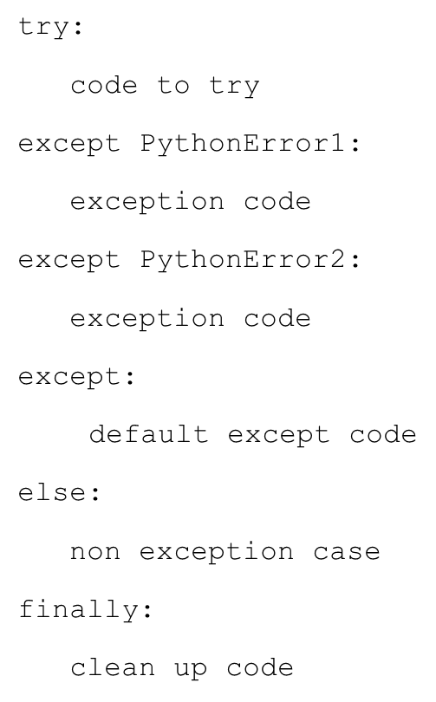
The whole thing

Slide 80
Code Listing 14-7

Slide 81
Raising and creating your own exceptions

Slide 82
Invoking Yourself, Raise
You can also choose to invoke the exception system anytime you like with the raise command
raise MyException
you can check for odd conditions, raise them as an error, then catch them
they must be part of the existing exception hierarchy in Python

Slide 83
Non-local catch
Interestingly, the except suite does not have to be right next to the try suite.
In fact, the except that catches a try error can be in another function
Python maintains a chain of function invocations. If an error occurs in a function and it cannot catch it, it looks to the function that called it to catch it

Slide 84
Make your own exception
You can make your own exception.
Exceptions are classes, so you can make a new exception by making a new subclass:
class MyException (IOError):
pass
When you make a new class, you can add your own exceptions.

Slide 85
Code Listing 14.9 Password Manager (1 of 2)

Slide 86
Code Listing 14.9 Password Manager (2 of 2)

Slide 87
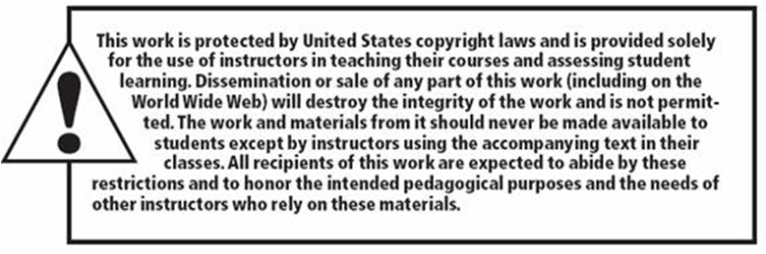
Copyright

